Slide 1
Rockbuster Stealth: Customer, Revenue, and Rental Analysis
By: Lashai Simon Lambert

Slide 2
Adapting to a Digital Future
With the rise of streaming platforms, Rockbuster Stealth LLC must adapt its traditional rental business to remain competitive.
The company plans to launch an online video rental service by leveraging its existing movie licenses.
This analysis used Rockbuster’s historical data to uncover the key insights and trends that will inform the best leadership strategy for the company’s digital expansion

Slide 3
Business Objective
Where are Rockbuster’s customers located?
Which countries generate the most revenue?
Are revenue and customer count aligned?
Who are the most valuable customers?
How do rental behaviors impact operations?

Slide 4
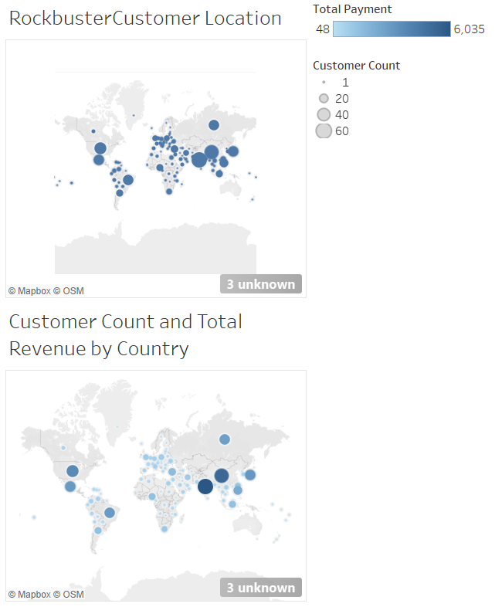
Where are Rockbuster Customers Located?
Customers are globally distributed with higher concentrations in Asia, Europe and North America
Some regions show high customer counts but lower revenue contribution

Slide 5
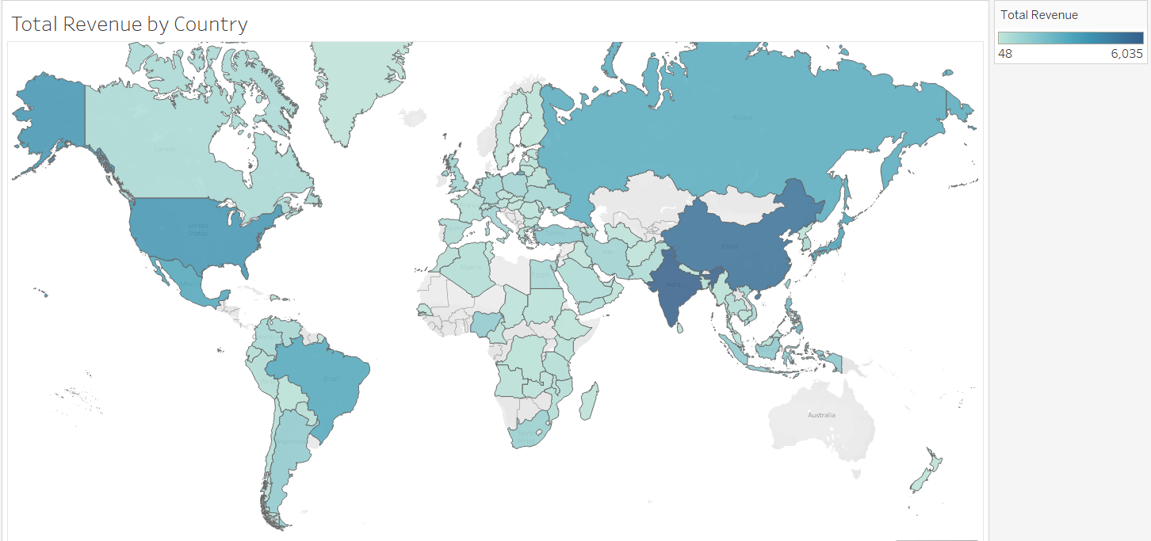
Revenue by Country
Revenue is unevenly distributed across countries
Not all countries with many customers generate high revenue

Slide 6
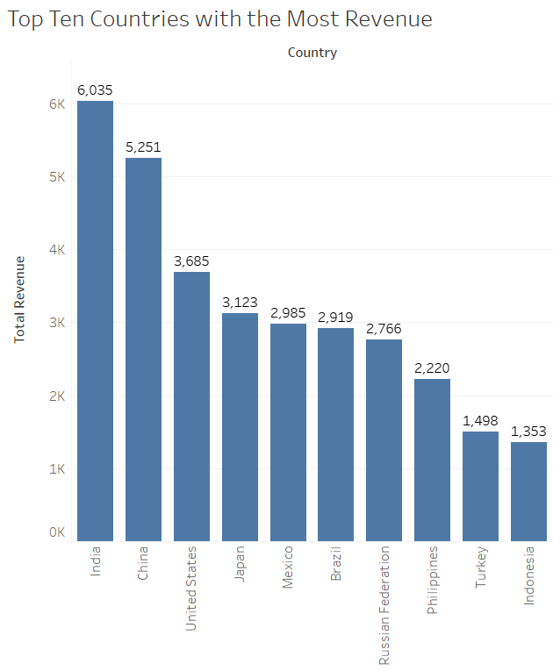
Top 10 Countries by Revenue
India and China are the top revenue generating countries
The top 3 countries contribute a significant portion of total revenue
Several countries generate relatively low revenue despite global presence.

Slide 7
Top Performing Customers
Sara Perry from Atlixco, Mexico is the top performing customer with a total amount of $128.70
Customer | City, Country | Total Amount Paid
Sara Perry | Atlixco, Mexico | $128.70
Gabriel Harder | Sivas, Turkey | $108.75
Serio Stanfield | Celaya, Mexico | $102.76
Clinton Buford | Aurora, United States | $98.76
Adam Gooch | Adoni, India | $97.80

Slide 8
Movie Rental Behavior Overview
Film lengths have a broad range with 115 minutes being the average.
Rental prices have an average rate of $2.98
Most movies are rented for 5 days and cost on average $19.98 to replace
Moving to a digital formal will remove this cost for the customer.
 | Minimum | Maximum | Average
Rental Duration | 3 days | 7 days | 5 days
Rental Rate | $0.99 | $4.99 | $2.98
Film Length | 46 minutes | 185 minutes | 115 minutes
Replacement Cost | $9.99 | $29.99 | $19.98

Slide 9
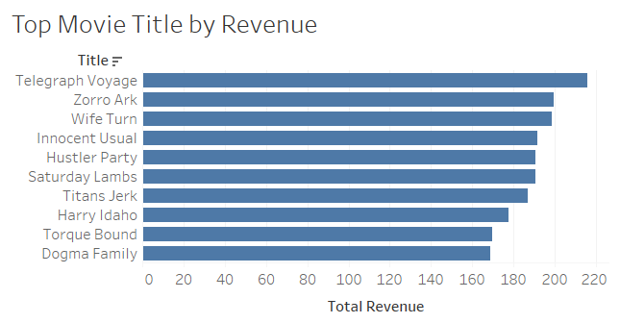
Top Movie Title
The top movie titles that were rented were Telegrapgh Voyage.
These are the top 10 movies titles based on revenue.
These movies have to be in the new streaming platform for Rockbuster.
In the marketing stage, these movies need to be shown as top movies which will draw customers in.

Slide 10
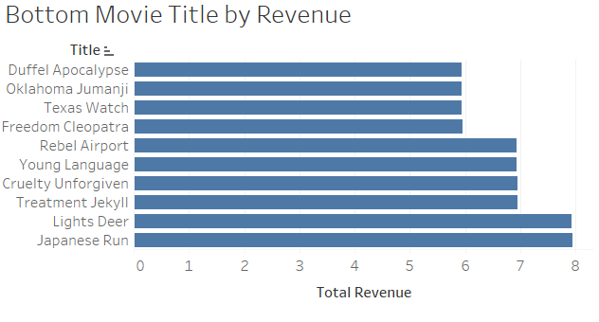
Let’s Not Add…
These are the bottom movie titles generate the least amount of revenue.
Duffle Apocalypse, Oklahoma Jumanji, and Texas Watch do not need to be add to the new platform.

Slide 11
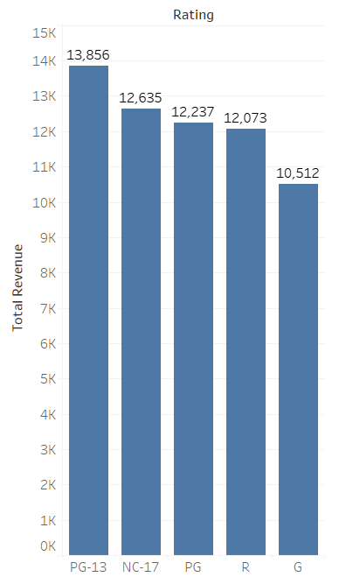
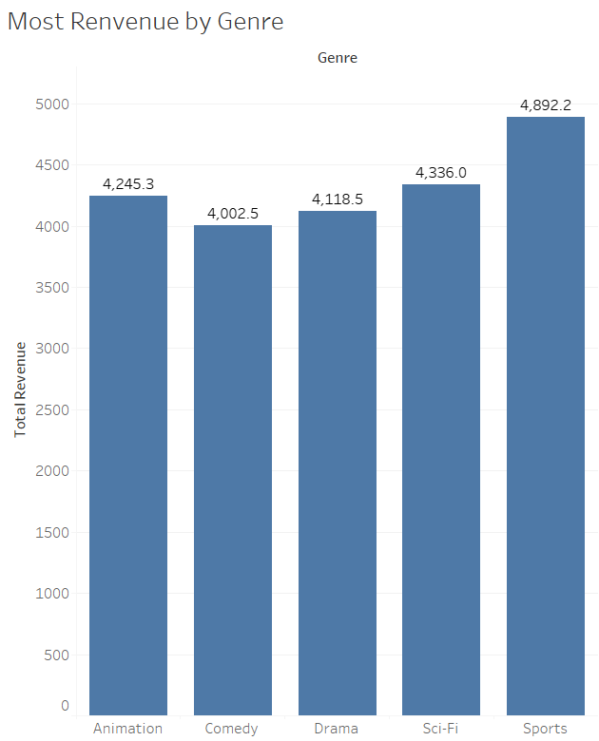
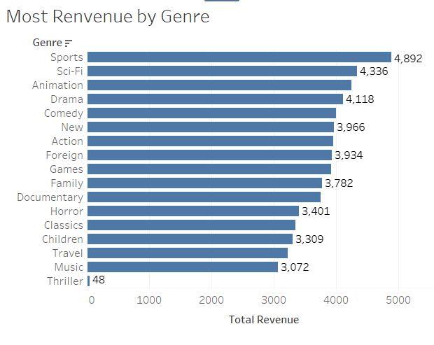
Revenue By Movie Genre and Rating
Based on Genre Sports, Sci-fi and Animation bring in the most revenue.
Lower performing genres such as Music and Thriller contribute significantly less to the total value
PG -13 creates the most revenue by rating while G creates the least

Slide 12
Business Recommendations
Focus marketing efforts on the top revenue countries India, China and Unites States first and then move in waves into the next few countries
When moving to the digital format, focus on movies that are PG-13, NC-17, and in Sports, Sci-fi and Animation.
There is a big international demand which would suggest the digital format would have multiple subtitle conversations and movies in the languages for the top revenue countries.

